Slide 1
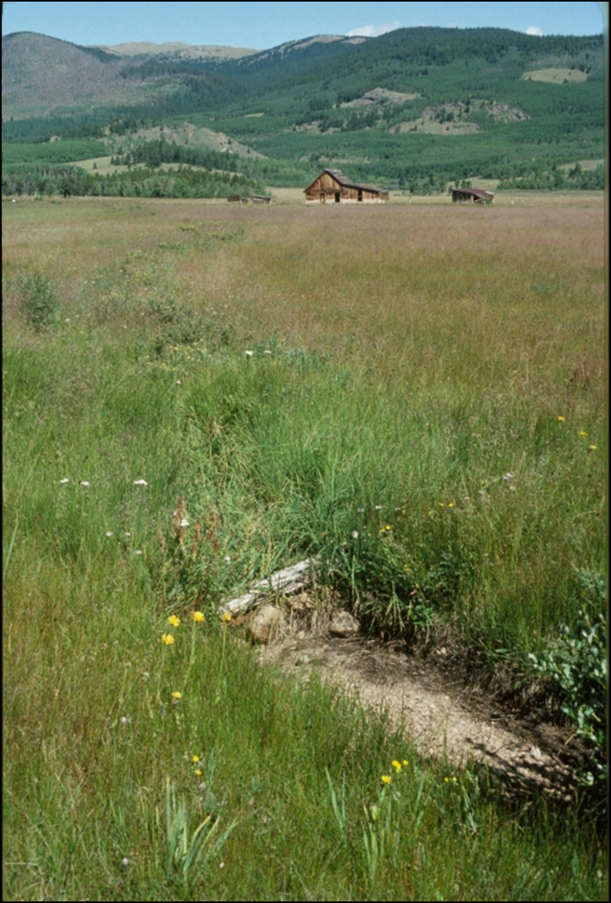
Colorado Water 2016
Colorado Housing Council
March 16, 2016
Patricia Flood, P.E.,
Certified General Appraiser
Wright Water Engineers, Inc

Slide 2
Colorado Water Plan Highlights
Front Range Water Neighborhood
Water Values – Wholesale & Retail
Challenges
  Regulatory, Conservation & Costs

Slide 3

History of Water Plan
  Drought 2002-2003
  2005 Governor Bill Owens
  9 Basin Roundtables & Interbasin Compact Commission (IBCC)
  2010 Statewide Water Supply Initiative (SWSI)
  2013 Governor Hickenlooper – Deadline for Final Plan by December 2015
  Final Plan Issued November 2015

Slide 4
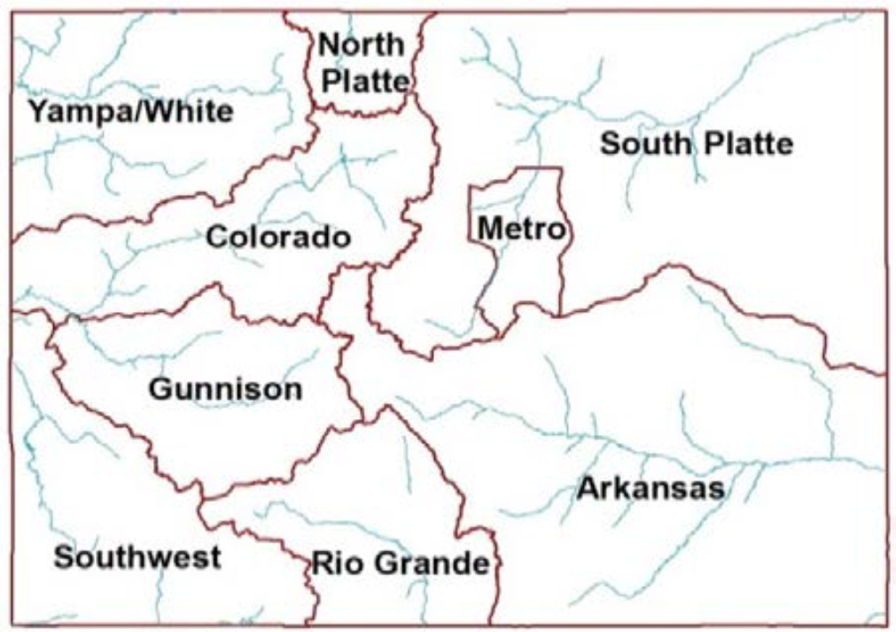
Roundtable Basins

Slide 5
Goals of Water Plan
Meet Water Needs:
  Municipal & Industrial (M&I)
  Agricultural
  Environmental & Recreational
Balance Competing Water Demands
Recognize Economic Contribution of Ag and Environmental & Recreation
Minimize “Buy and Dry”

Slide 6
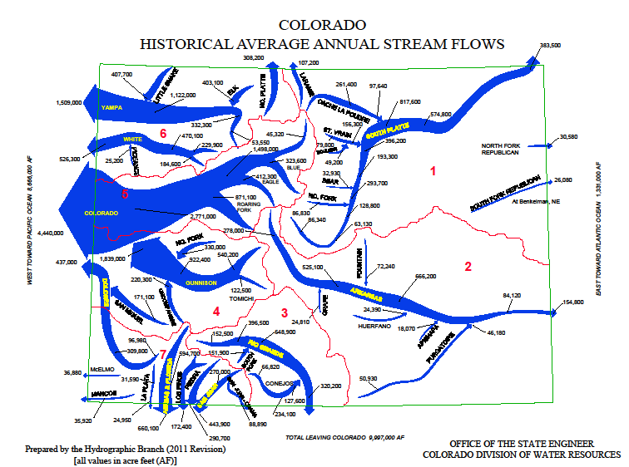

Slide 7
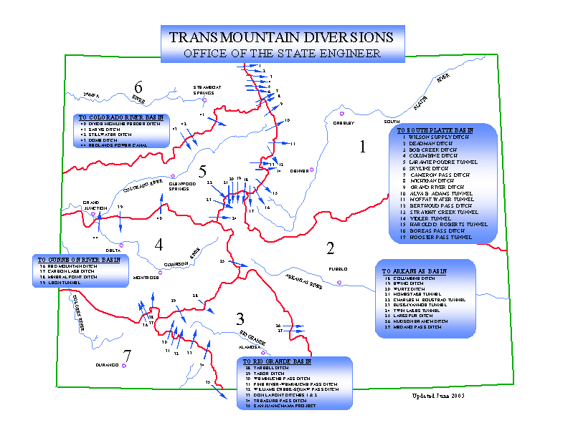

Slide 8
PROCESS
9 Basin Roundtables
Interbasin Compact Commission (IBCC)
Basin Roundtable Public Meetings
Identify water needs thru Year 2050
Identify Projects and Processes (IPPs)
Difference between Needs & IPPs is Gap
Basin Implementation Plans (BIP)
Goal to close Gap by Year 2030

Slide 9
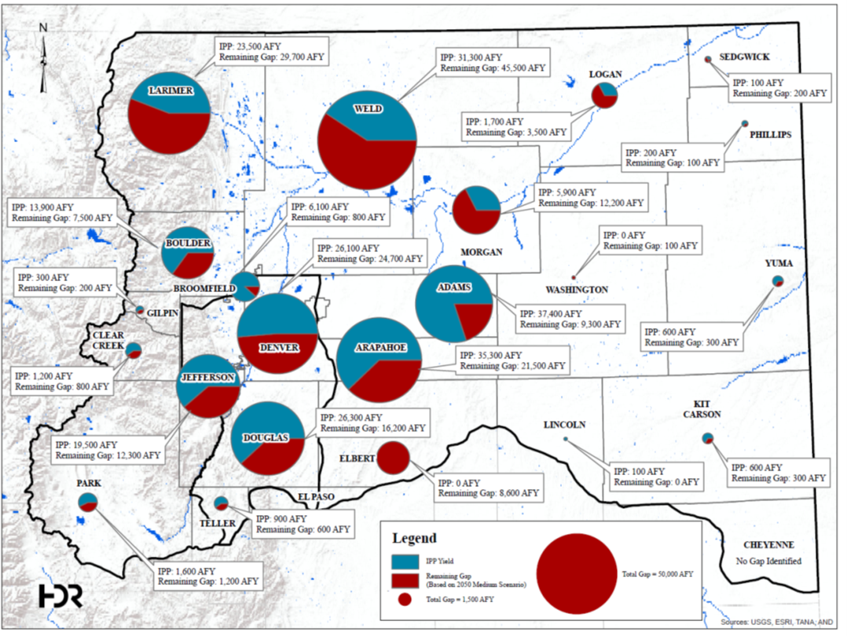
South Platte & Metro Projects and Gaps

Slide 10
Gap – Mid-Range Scenario

Slide 11
Gap – High Needs Scenario

Slide 12
Measures to Fill Gap

Slide 13
CONSERVATION

Slide 14
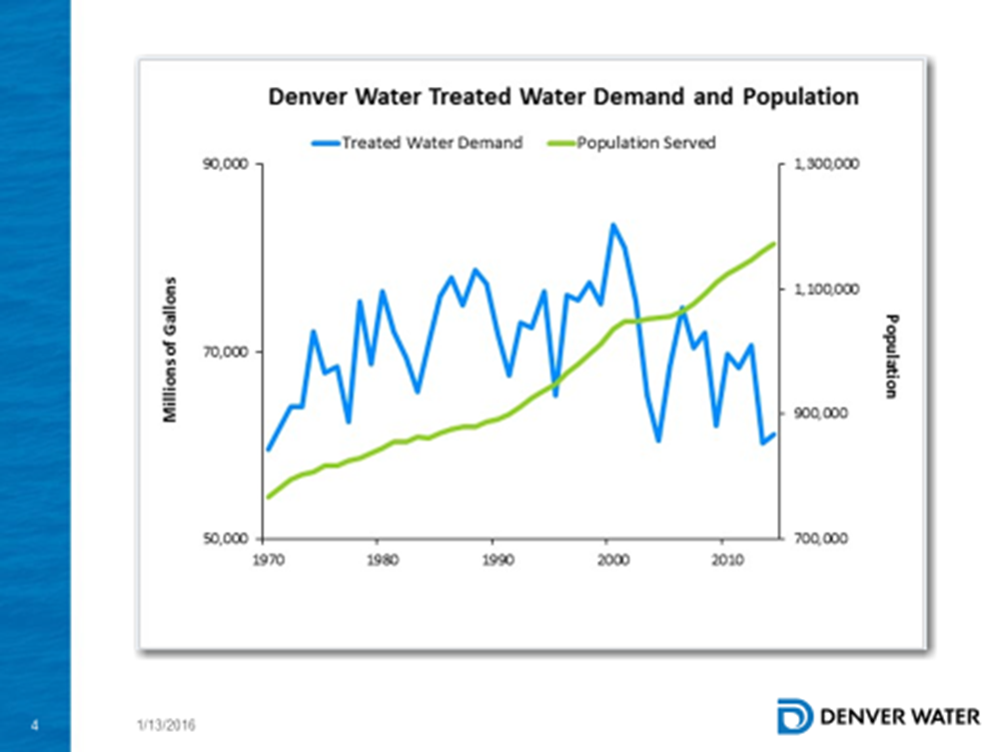

Slide 15
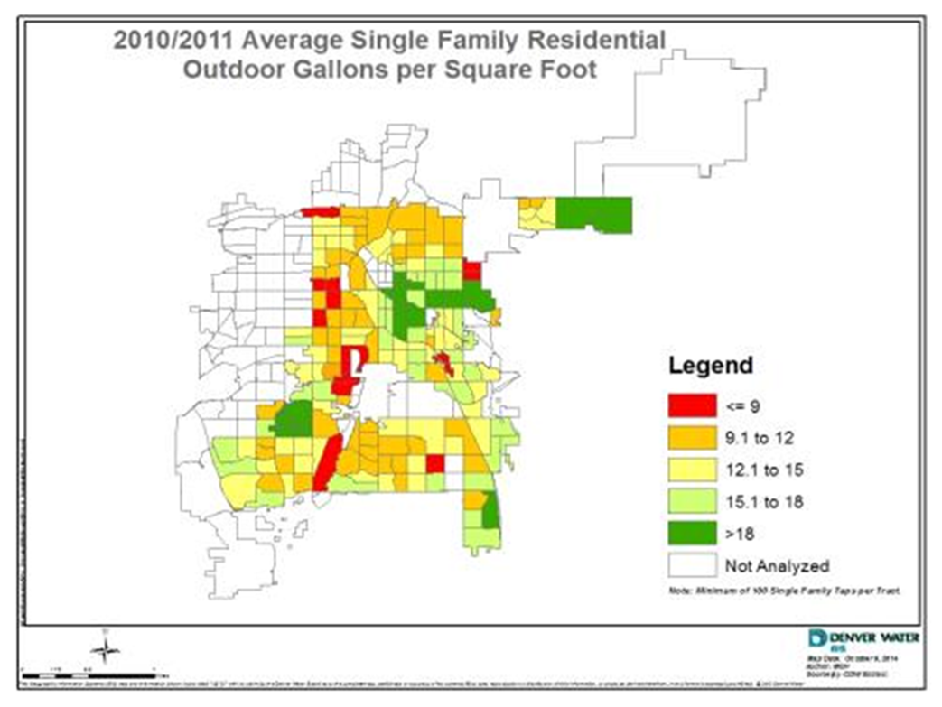

Slide 16
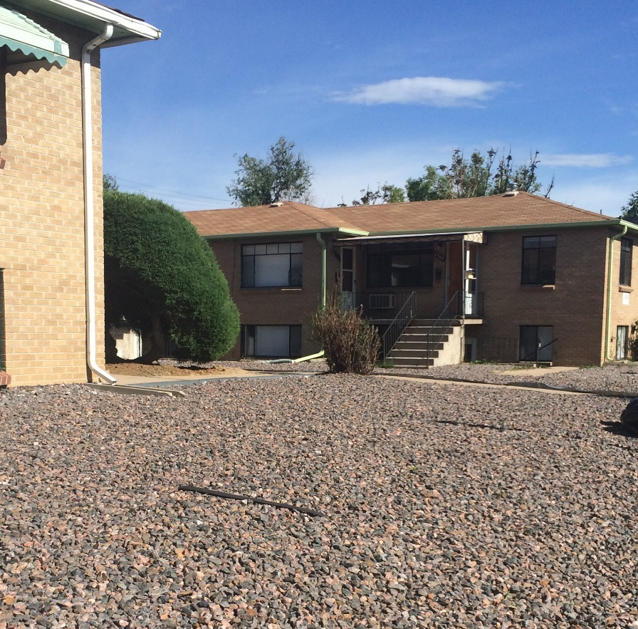
Conservation Challenge
Good Customer Response in Drought
Rebound Effect
Conversion of Properties
Concentrate Conservation Efforts on those Overwatering

Slide 17
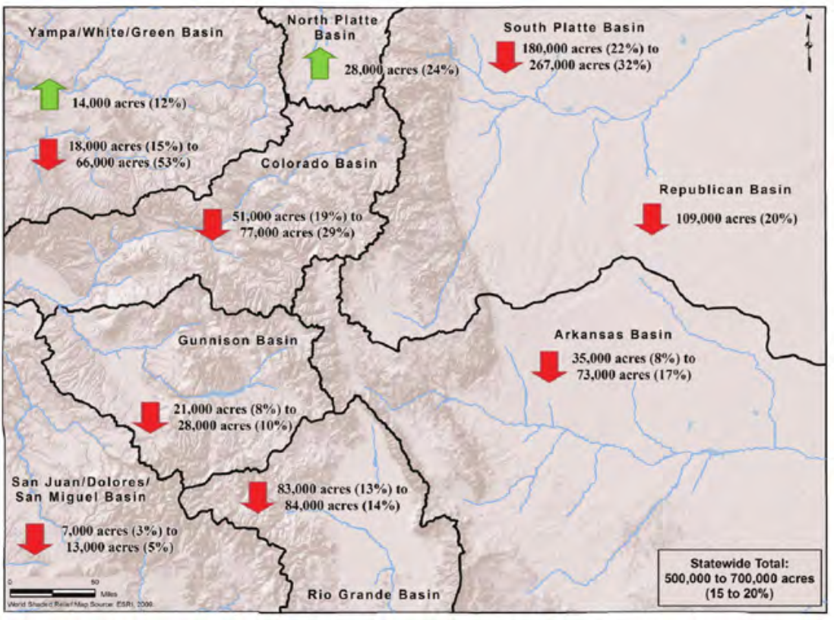
Potential Changes in Irrigated Acreage by 2050
(Figure 6-2 Colorado Water Plan)

Slide 18
Front Range Water Neighborhood
Transmountain Diversions (TMDs)
  Moffat Tunnel Expansion
  Northern Integrated Supply System (NISP)
Pipeline Projects
  Aurora Prairie Waters Project
  East Cherry Creek Water & Sanitation (ECCV) & Arapahoe County Water & Wastewater Authority
  Water Integrated Supply Efficiency (WISE) Project
  City of Thornton Northern Project – Cache La Poudre Supplies
  Southern Delivery System (SDS) – Colorado Springs

Slide 19
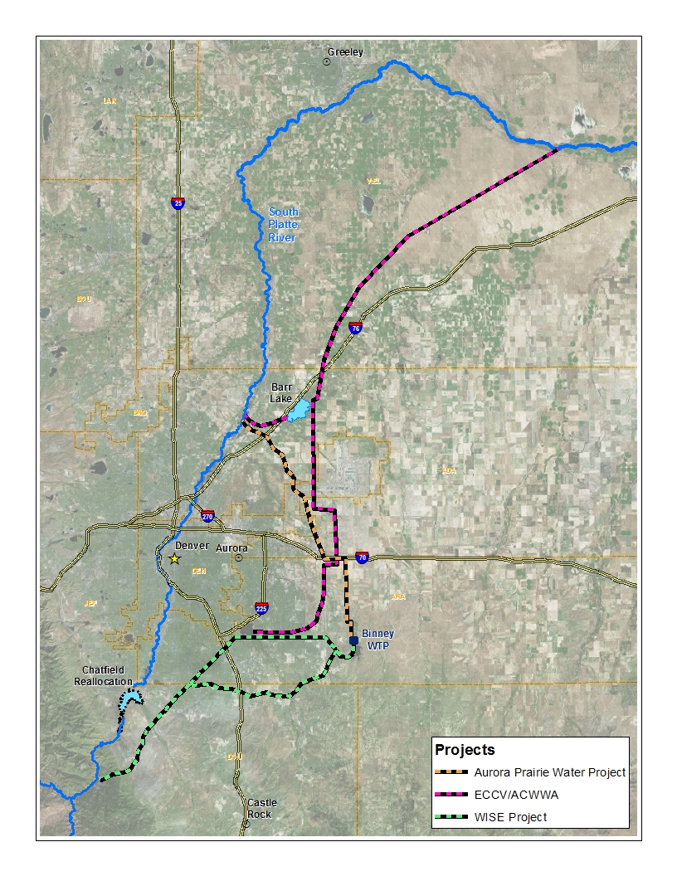

Slide 20
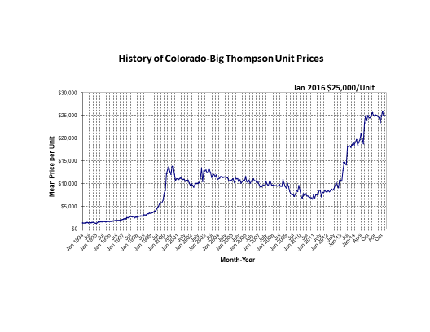

Slide 21
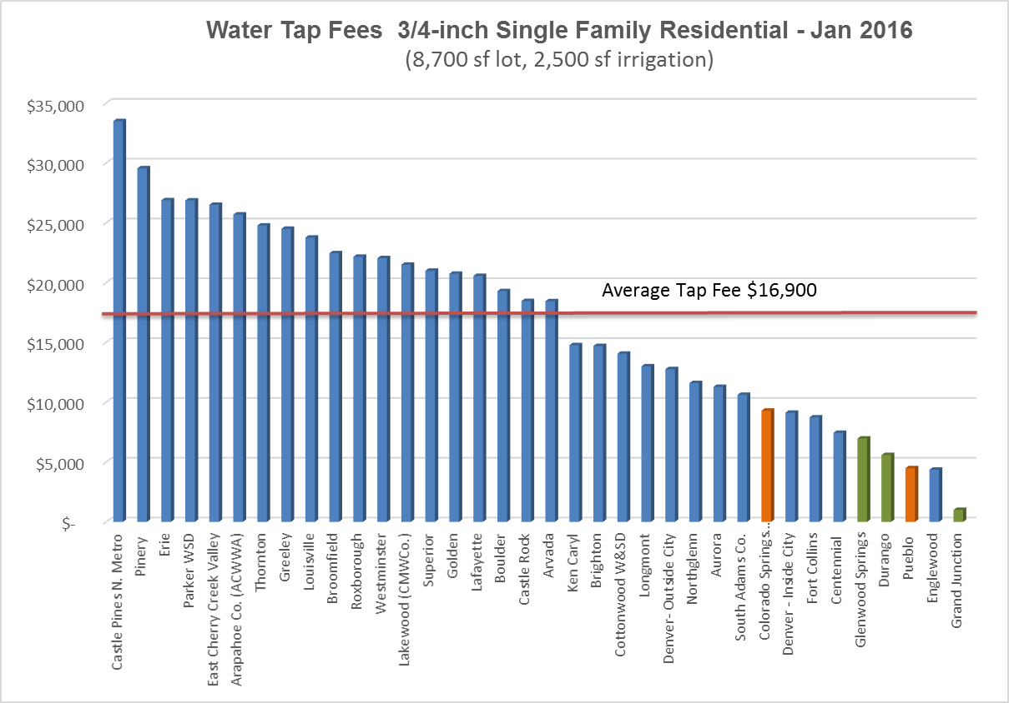

Slide 22
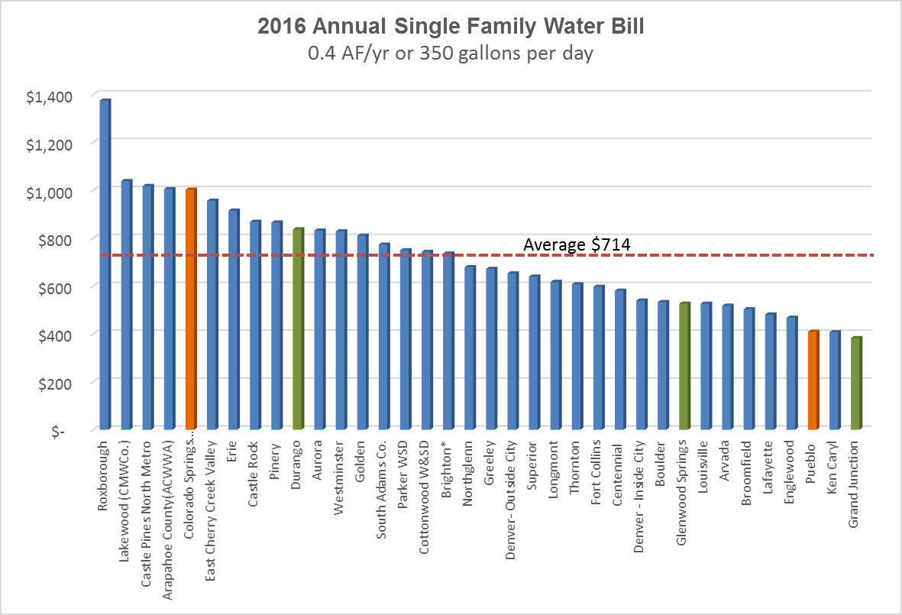

Slide 23
Challenges
Regulatory Issues
  Alternative Ag Transfers
  Tightening Administration by State Engineers Office
  High Transaction Costs
  Permitting and timing issues for New Projects
Climate Change
  Higher Temperatures
  Change in Stream Regimes
Funding of Projects

Slide 24
2015 GreenCO
Industry looking ahead to meeting conservation needs
Literature research
Northern Water
Aquacraft studies

Slide 25
Front Range Savings Estimates
Xeriscape/plant selection:
  2.0 to 5.5 gpsf for replacement of lawn areas with shrubs, ground covers and perennials
  5.9-11.5 gpsf if the replacement is low-water xeric plants
Irrigation Audits
  1.3 to 3.3 gpsf for improving irrigation efficiency in response to irrigation audits
Irrigation system technology and retrofits—wide variation in studies, some examples:
  4.8 gpsf replaced of old irrigation system with modern systems
  3.3 gpsf for weather based irrigation controllers BUT…
  Converting manual watering to automated systems typically results in an increase in water use.
  Benefits of advanced weather-based irrigation controllers are greatest when targeted to properties that are over-irrigating

Slide 26
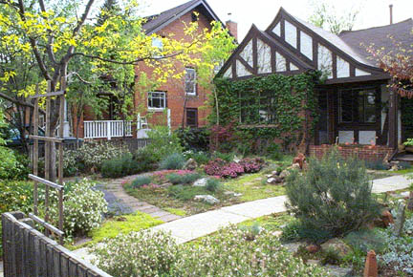
Outdoor Water Conservation
Irrigation technology
Water use/efficiency audits
Plant-related practices pertaining to xeriscape or turf conversion to plants with lower water use requirements
Tiered Water Rates and Water Budgets

Slide 27
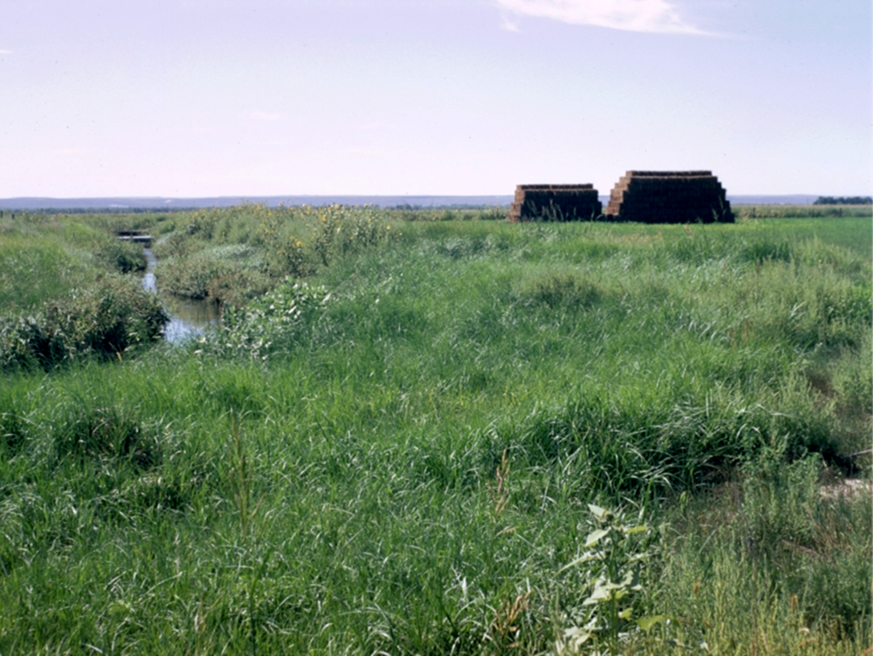
Questions?
http://coloradowaterplan.com

